Slide 1

POISON
REMNANTS

Slide 2
POISON
REMNANTS
THE DEVELOPER TEAM
Samantha Heisterkamp, Database Administrator
Chad Rousseau, Scrum Master
Ken Pederson, Repo Owner
OVERVIEW
Introduction
Methodologies
Talking About Code
Application Demonstration
Remaining Challenges
Lessons Learned

Slide 3
POISON
REMNANTS
Introduction
Ken Pederson
What we did
Why we did it
Who we did it for

Slide 4
POISON
REMNANTS
Methodologies
-how we did it-
Ken Pederson
OVERVIEW
Agile
Trello
Wiring Diagram
README

Slide 5
POISON
REMNANTS
Methodologies
AGILE
Planning
Executing
Evaluating

Slide 6
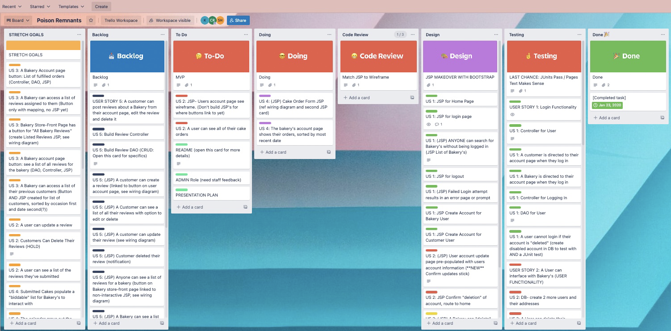
POISON
REMNANTS

Slide 7
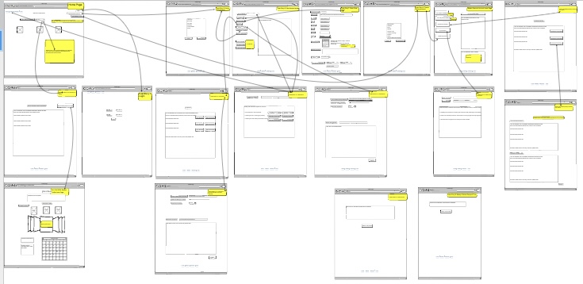
POISON
REMNANTS

Slide 8
POISON
REMNANTS
POISON REMNANT README

Slide 9
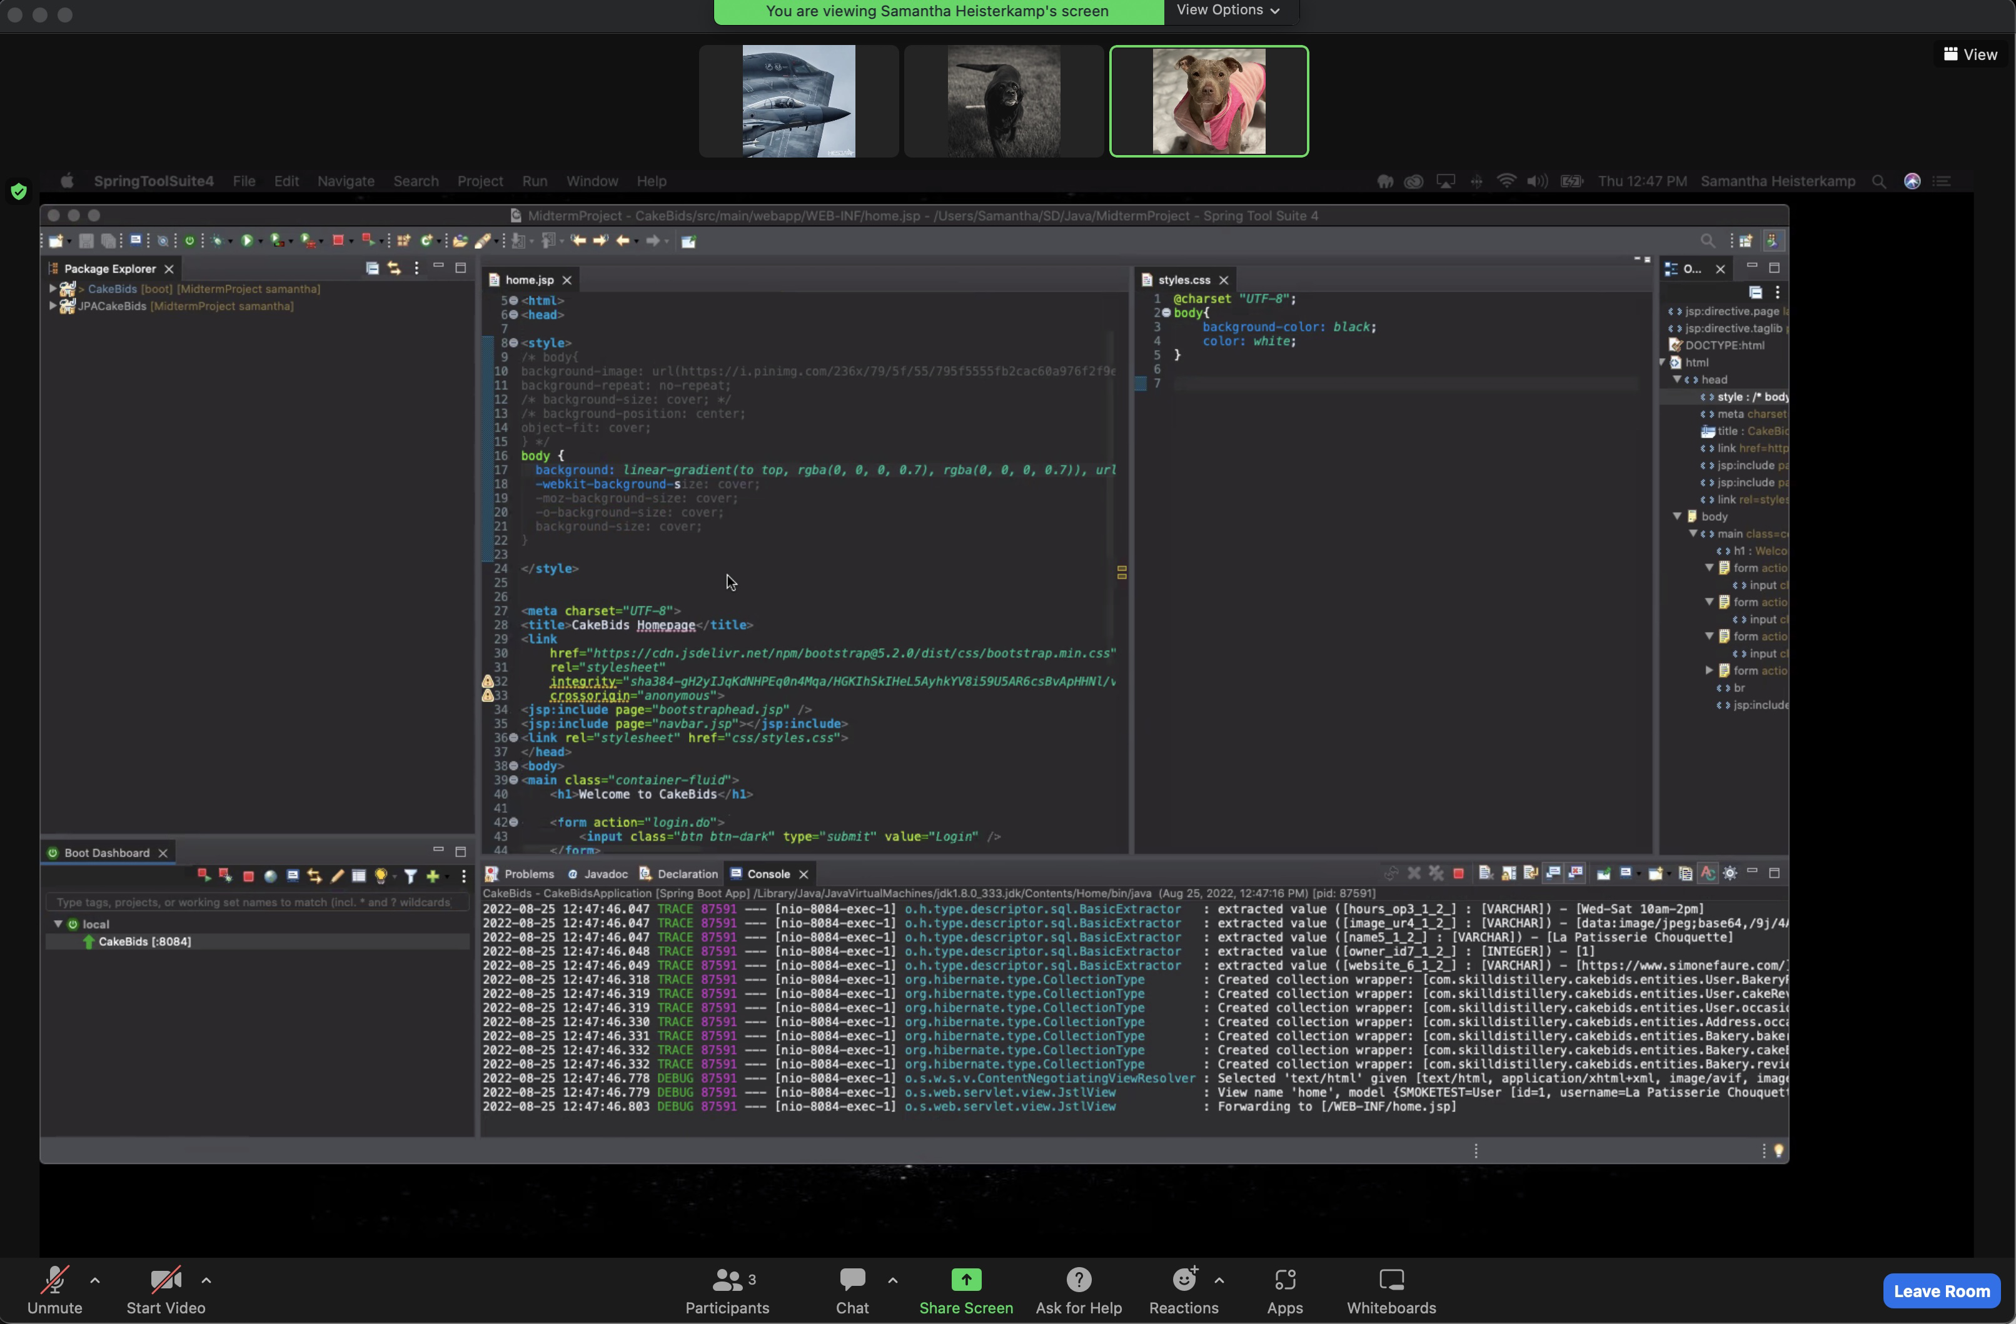
POISON
REMNANTS
Talking About Code
Samantha Heisterkamp

Slide 10
POISON
REMNANTS
Application Demonstration
Samantha Heisterkamp

Slide 11
POISON
REMNANTS
Remaining Challenges
Chad Rousseau
OVERVIEW
Bidding Capabilities
Customer Reviews & Bakery Responses

Slide 12
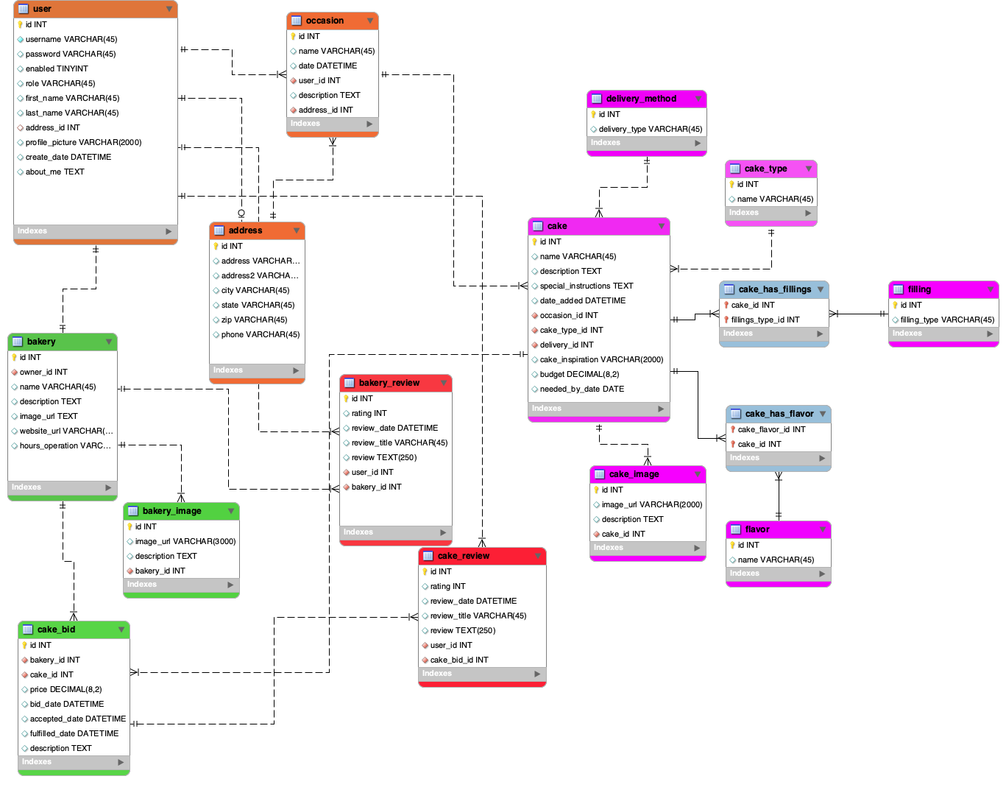
POISON
REMNANTS

Slide 13
POISON
REMNANTS
If We Did It Again
Poison Remnant

Slide 14
POISON
REMNANTS
Review
Methodologies
Application Demonstration
Remaining Challenges
Lessons Learned

Slide 15
POISON
REMNANTS
Questions

